Slide 1
Lab assignment 1
Learning and generalisation in feed-forward networks — from perceptron learning to backprop
Group 4
Chiachen Ho, Angelos Stais and Ruxue Zeng
September 17, 2021
Artificial Neural Networks and Deep Architectures, DD2437

Slide 2
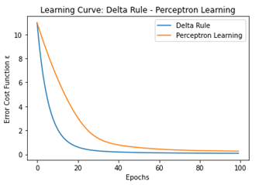
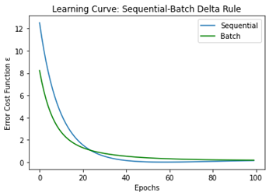
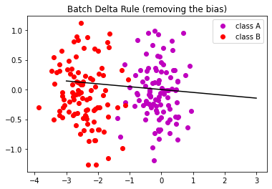
Classification
Single Layer Perceptron - Linearly Separable Dataset
Conclusions :
𝛈 (learning rate): 0.0001 appropriate value
Delta Rule in Batch Mode – Perceptron Learning: Delta Rule converges faster and decision boundary of Perceptron Learning is closer to the limit points
Sequential – Batch Learning with Delta Rule: Similar results, with Sequential Delta Rule converging a little quicker
Removing bias in Batch Delta Rule: The perceptron is not able to classify the samples in many cases
Notes:
At first we implemented and applied percpetron learning rules and analysed the results
η 0.0001 (One ten-thousandth) seems to be an appropriate value for both algorithms to converge at around 100-200 epochs depending on the generated dataset. If a greater value is applied the error diverges. If a smaller value is applied the convergence of the algorithms is slowed down.
From the comparing graphs, Delta Rule is preferable because converges a lot faster for the same learning rate and also because the decision boundary of Perceptron Learning is close to the limit points which leads to a higher possibility of misclassification of some data
Linearly Separable Dataset: Sequential – Batch Learning with Delta Rule
The two versions of Delta Rule achieve similar results with Sequential Delta Rule converging a little quicker to a lower mean square error.
Removing Bias in Batch Delta Rule
Having removed the bias the perceptron is not able to classify the samples if one of the classes has a mean which is almost the origin, even after as many as 1000 epochs. The error will not converge to 0 and the perceptron is not able to correctly classify the sample from one or both of the classes

Slide 3
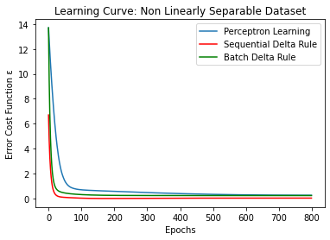
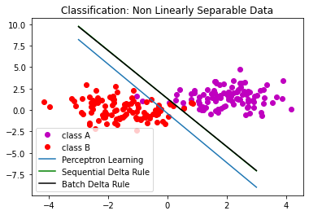
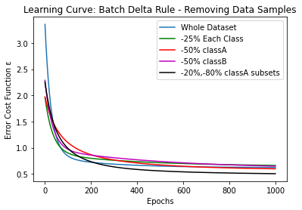
Classification
Single Layer Perceptron - Non Linearly Separable Dataset
Conclusions :
Delta Rule in Batch, Sequential Mode – Perceptron Learning: Perceptron Learning slower. Sequential and Batch Delta Rule converge to lower error.
Different Versions of Non-Linearly Separable Dataset: Error remains more or less close to having the whole dataset, the algorithm converges a little slower as we remove more samples and the decision boundary moves tο corresponding direction. In the last scenario, the decision boundary is totally different.
All the algorithms misclassify some data.
Notes:
Delta Rule in Batch, Sequential Mode – Perceptron Learning: Perceptron Learning is significantly slower than both versions of Delta Rule. Sequential and Batch Delta Rule converge to lower mean square error. All the algorithms misclassify some data as expected.
Different Versions of Non-Linearly Separable Dataset: if we remove some samples from each class the mean square error remains more or less close to having the whole dataset, the algorithm converges a little slower as we remove more samples and the decision boundary moves a little bit tο corresponding direction. In the last scenario, the decision boundary is totally different. Indeed we have almost removed all the samples from class A which had a positive abscissa so the dataset is now almost linearly separable.
Of course same data are always miscclasified because we have a single perceptron which can not classify non linearly separable datasets

Slide 4
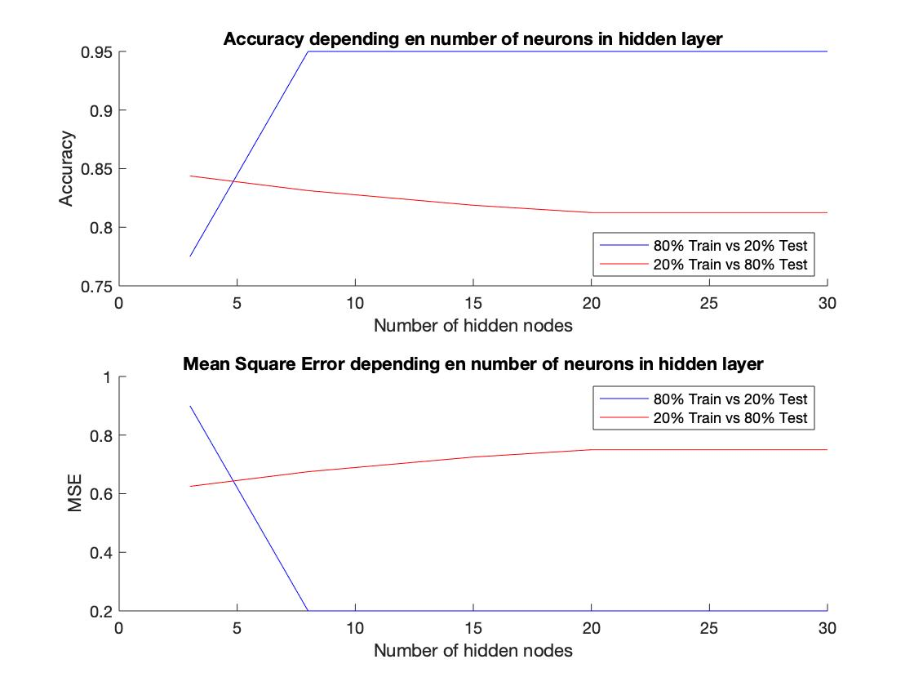
Classification
The number of training data
Conclusions :
Network with 80% Training data has lower MSE.
Accuracy of network is positively affected by the number of training samples.
With few Training data, the number of hidden nodes won’t affect a lot the accuracy of network.
Notes:
In the second part of assignment one, we have built a two-layer perceptron network with Backprop using generalized Delta rule. First of all, we want to examine how well it performs in separating linearly non-separable data.
Particularly, we splited one dataset to 2 with 2 different ways, the first one with 80% for training and 20% for validation. And second one is the opposite. Clearly, what we could see from this figure, it’s that the network trained with 80% data has lower Mean Square Error. And the speed of convergence is very quick, with 8 nodes, we attent our accuracy maximum that we could attent.
But with 20% training data, the MSE and accuracy seem stable. What we conclude is the accuracy of network is positively affected by the number of training samples. And with few training data, the number of hidden nodes won’t affect a lot the accuracy of network.

Slide 5
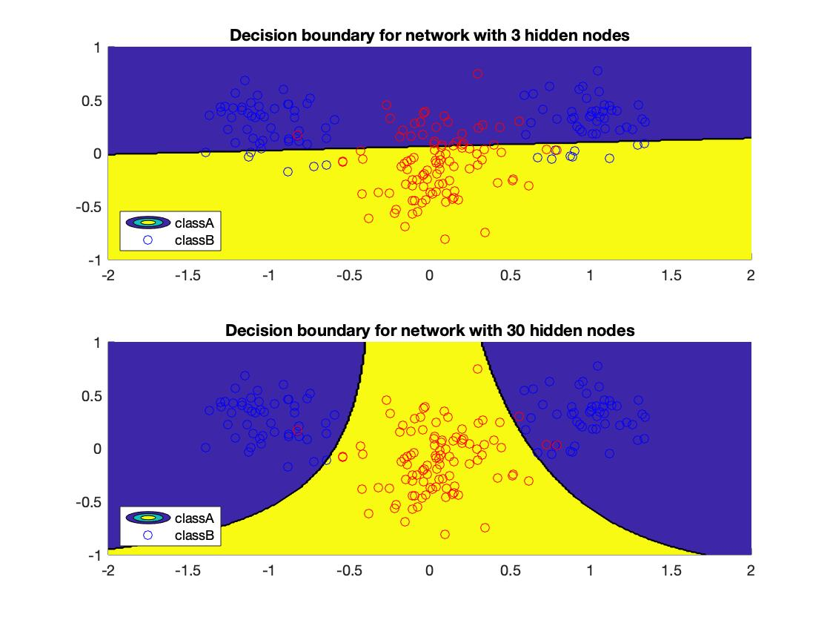
Classification
The number of hidden nodes
Conclusions :
Network with 30 hidden nodes has a decision boundary more correct.
When we have sufficient number of samples for training, the number of hidden nodes affect positively the accuracy of network
Notes:
With the previous figure, we have already observed the affect of number of hidden nodes to the network. Now, we have build the decision boundary for network with 3 hidden nodes and 30 hidden nodes.
We remark that the decision boundary with 3 hidden nodes is more like a linear separation. But the one with 30 hidden nodes is more like the non linear transfer function we used to build the network.
To conclude, the network with 30 hidden nodes has a decision boundary more correct. So, when we have sufficient number of samples for training , the number of hidden nodes do affect positively the accuracy of network.

Slide 6
Function approximation
The number of training data
 | Variance | Bias | MSE
80% Train VS 20% Valid | 0.0459 | 0.0060 | 0.0020
20% Train VS 80% Valid | 0.0480 | 0.0171 | 0.0077
Conclusions :
Network with 80% Training data has a lower MSE and bias.
A network train with a small subset has a poor sensibility.
Notes:
What we want also do with the two-layer perceptron network is to use it to approximate the well-known bell-shell Gauss function.
To evaluate the generalization of our network, we have chosen to use mean square error. Apparently, the number of hidden nodes affect a lot the approximation. With a few number of hidden nodes, the approximation is underfitting, but with too many, we risks overfitting.
As for the classification part, we also test our algorithm with two differents dataset with different number of training data. This time, we have chosen to compare their variance, bias and mse. What we observe is that the variance between two networks are equivalent, but the natwork with 80% training data has a lower MSE and bias, about three times smaller.
What we conclude is that a network train with a small subset has a poor sensibility. Furthermore, we think that which part of the input space training data situated could also affect the generalization , because the correlation between samples is important. To verify this, we could calculate the variance using bootstrap approach or n-fold cross-validation, which we didn’t do for this lab.

Slide 7
MG time series prediction
Model : MLPRegressor (framework : sklearn)
Settings:
solver: lbfgs
alpha : 0.001
max_iter : 10000
Validation fraction: 0.1
number of simulations: 10
early stop: True (for sgd)
n_iter_no_change (for sgd): 10
Validation score (n1: number of nodes in hidden layer1, n2: number of nodes in hidden layer2)
n1/n2 | 2 | 5 | 15
2 | 0.430 | 0.802 | 0.814
4 | 0.571 | 0.933 | 0.967
Conclusion :
Best model is the one with most nodes in both h1&h2

Slide 8
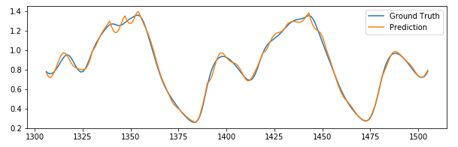
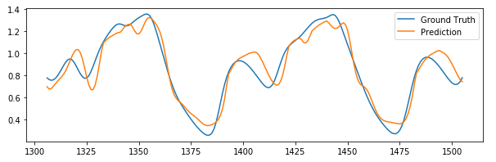
MG time series prediction
Best model VS Worst model
Best model
num of nodes in h1 &h2 : (4,15)
MSE : 0.0012
Worst model
num of nodes in h1 &h2 : (2,2)
MSE : 0.0093

Slide 9
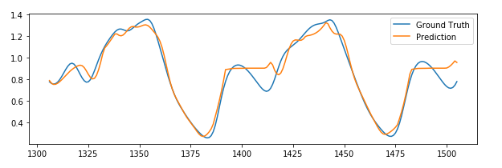
MG time series prediction
Best model with different optimizer
Best model (with lbgfs)
num of nodes in h1 &h2 : (4,15)
MSE : 0.0012
Best model (with sgd)
num of nodes in h1 &h2 : (4,15)
MSE : 0.0052

Slide 10
MG time series prediction
Exploring different hyperparameters with noisy data
Sigma=0.05
Conclusion:
When n2 is small, it heavily relies on initialization of model weight
When noise is more spread out, all models perform worst than itself with the same setting
Overall, with noise introduced, models with larger alpha perform better
n2/alpha | 10e-1 | 10e-2 | 10e-5
2 | 0.227 (0.01) | 0.282 (0.23) | 0.365 (0.22)
5 | 0.495 (0.02) | 0.414 (0.19) | 0.445 (0.15)
15 | 0.536 (0.01) | 0.545 (0.03) | 0.544 (0.02)
Sigma=0.3
n2/alpha | 10e-1 | 10e-2 | 10e-5
2 | 0.213 (0.17) | 0.141(0.11) | 0.169 (0.14)
5 | 0.440 (0.10) | 0.409 (0.05) | 0.443 (0.11)
15 | 0.500 (0.06) | 0.481(0.08) | 0.465 (0.07)

